Slide 1
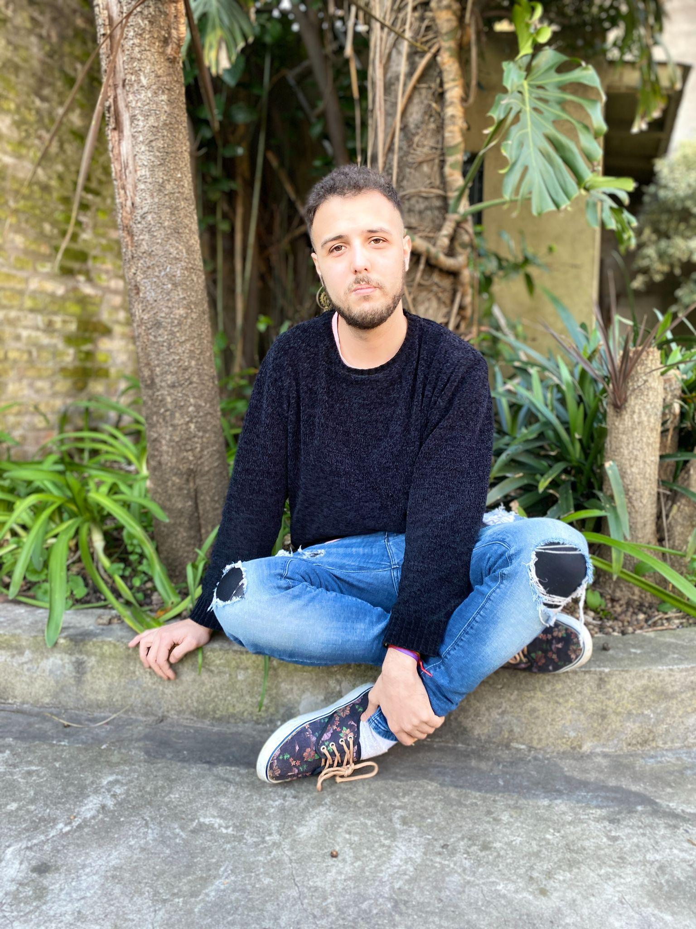
ORGANIC HOUSE - PROGRESSIVE HOUSE- DEEP HOUSE
DJ SET
LUCEFORA
LUCEFORA
LUCEFORA
SEE MORE / VER MÁS

Slide 2

MUSIC
MUSIC
MUSIC
VENUES / EVENTOS

Slide 3

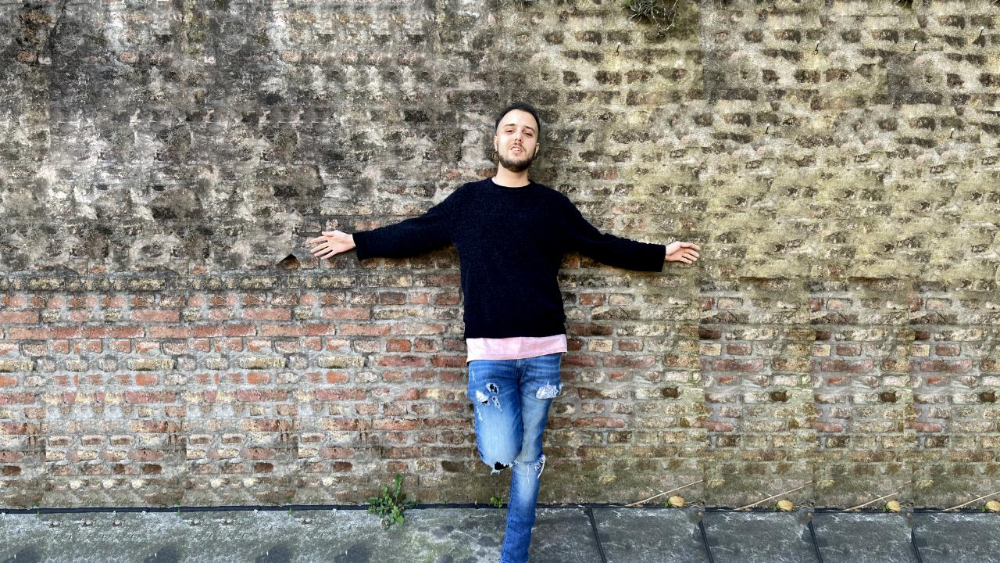
MUSIC - LABELS
All Day I Dream - Akbal Music - Kindisch - VIVa Music Tale & Tone - Beatfreak - When We Dip XYZ
HMWL -Hoomidaas
MORE / MÁS

Slide 4



RELEASE HIGHLIGHTS
ELEMENTS
SPIRITS OF THE SOUTH
El Valle De Los Cisnes D-Formation Remix
LUCEFORA
[All Day I dream]
LUCEFORA & FACUNDO LOSARDO
[Tale & Tone]
LUCEFORA
[Beatfreak]
DISCOGRAPHY
Beatport (See all)
Spotify (Artist Profile)

Slide 5

DJ SET
Beatfreak Radio Show By D-Formation #257 | Lucefora

Slide 6

Booking requests, questions welcome
agustin@condortunes.com

